Slide 1
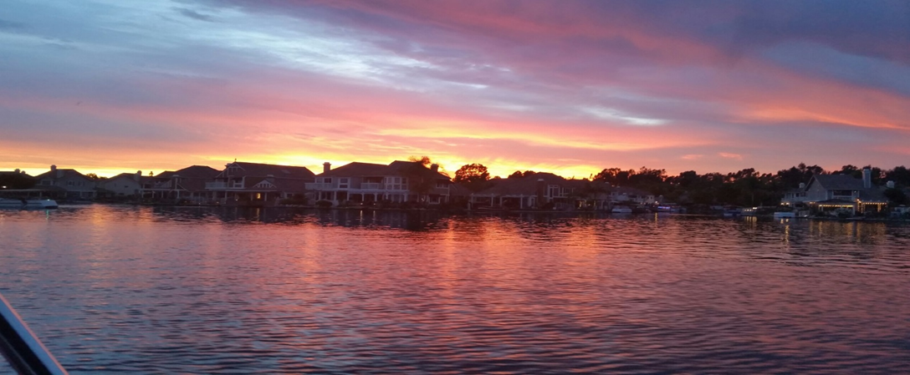
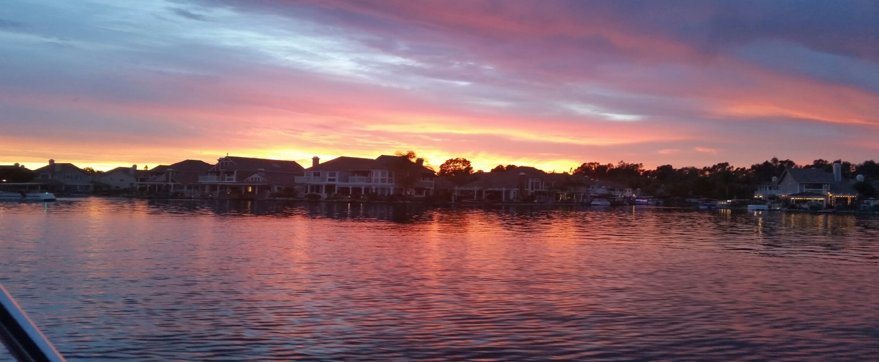
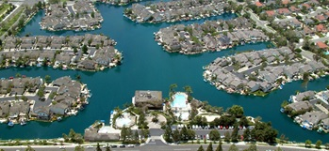
East Lake Village Shores Community Association
2017 Annual Meeting

Slide 2
East Lake Village Shores Community Association
Street Rehabilitation & Paving Plan

Slide 3
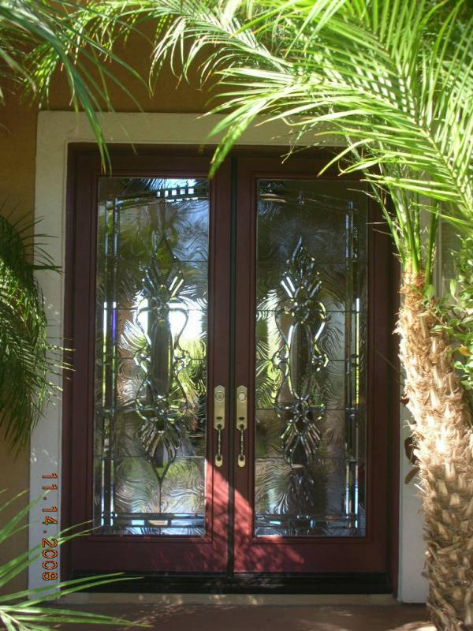
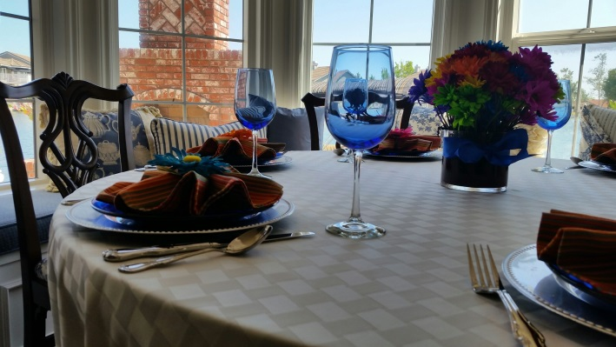
A New Street
A Re-Newed Neighborhood
Retained Value
Pride in Community

Slide 4
BACKGROUND
Average Lifespan for Asphalt Streets: ~30 Years
Approximate Age of The Streets:
In Excess Of 35 Years

Slide 5
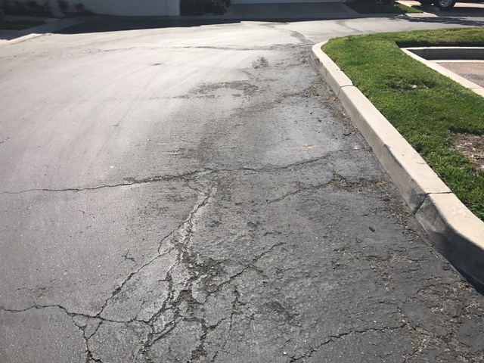
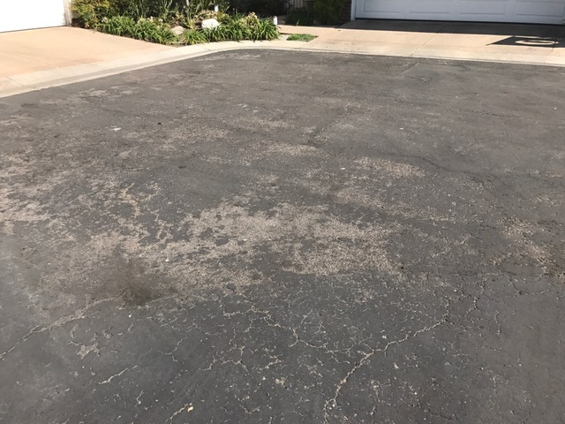
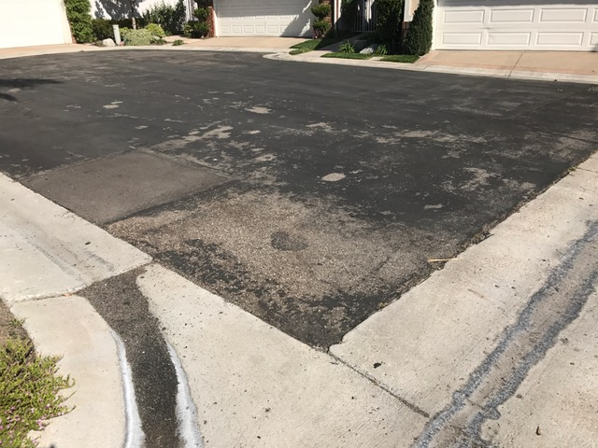
Current Conditions

Slide 6
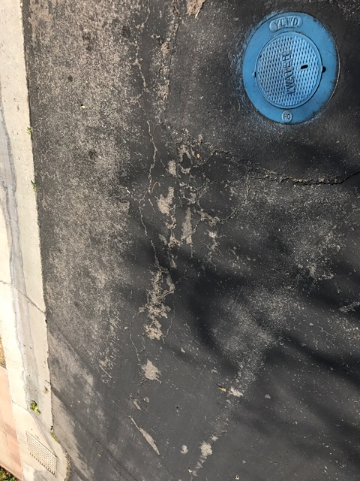
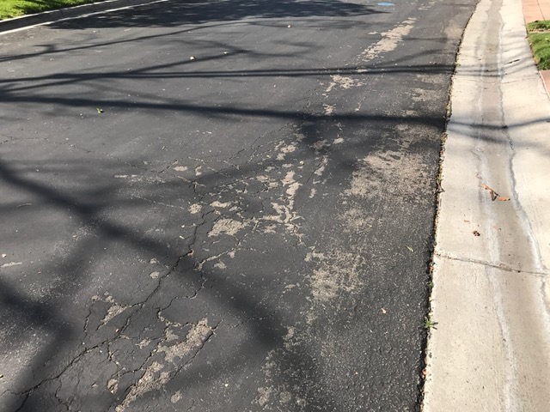
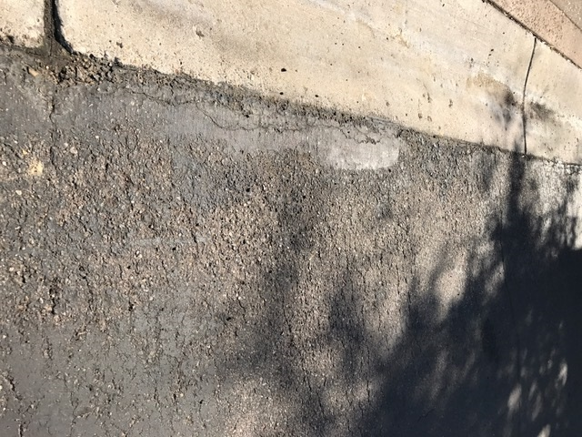

Slide 7
Maintenance Limited to Periodic Slurry Treatment (~Every 4 Years)
Historical Costs: ~$40,000 - $60,000
Historically Reserve Funds Were Allocated for Maintenance Only

Slide 8
ACTION TO DATE
Initial Review by Mr. Phil Winkler
Retained LaBelle/Marvin

Slide 9
Phase I Asphalt Rehabilitation Evaluation (Complete)
Pavement Evaluations
Pavement Coring and Laboratory Testing
Rehabilitation Plans and Specifications
Pavement Prioritization
Cost Estimates
Bidding Documents

Slide 10
Phase II Bid and Proposal Services
(In Process)
Bidders Solicitation
Contract Agreement
Material and Project Specifications
Bid Review Services

Slide 11
Phase III
Construction Management and Supervision
(Pending)
Materials and Equipment Submittals
Preconstruction Meetings
Construction Inspection and Supervision

Slide 12
LaBelle/Marvin
Ed Perez

Slide 13
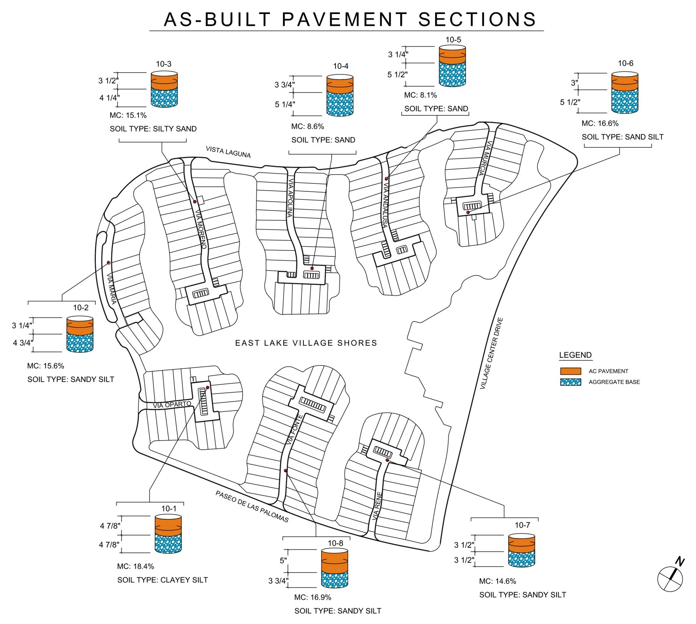

Slide 14
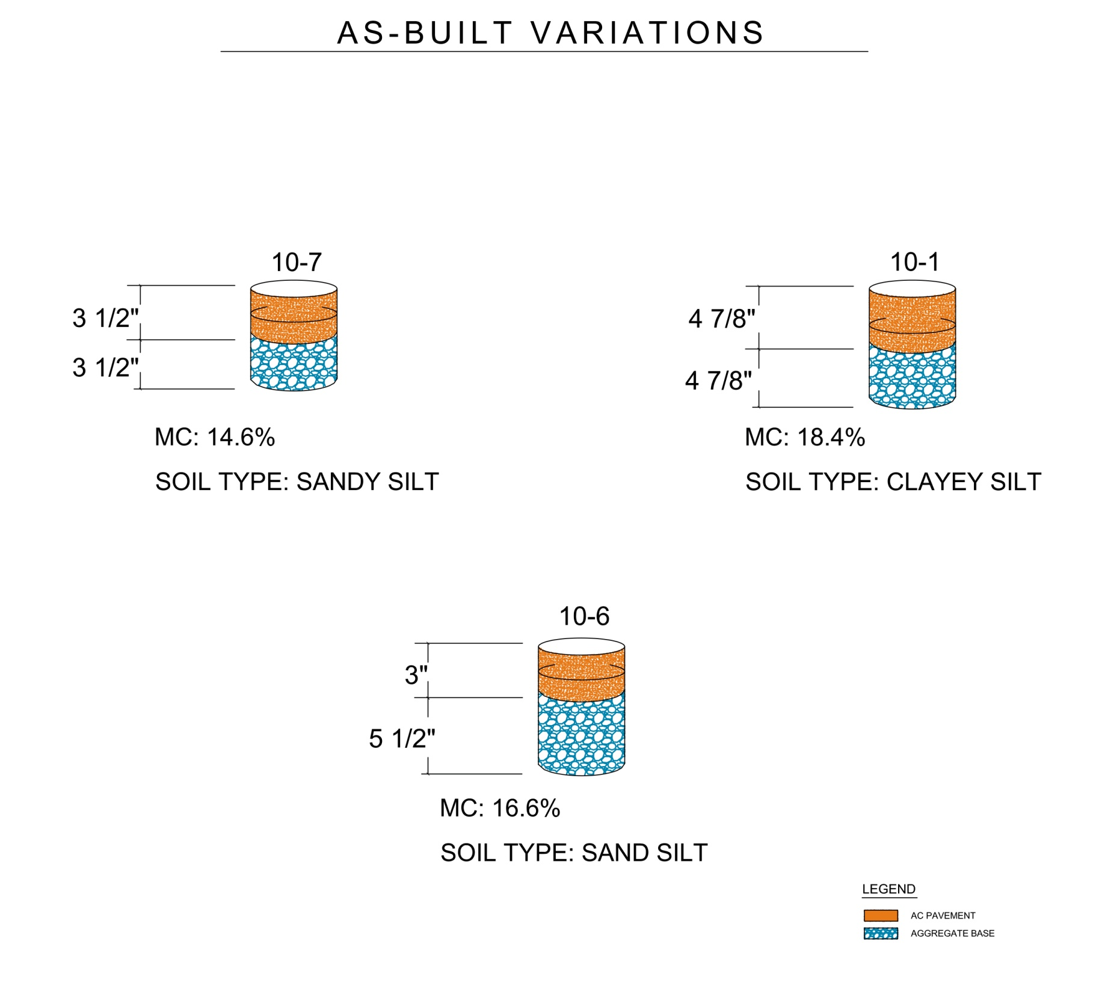
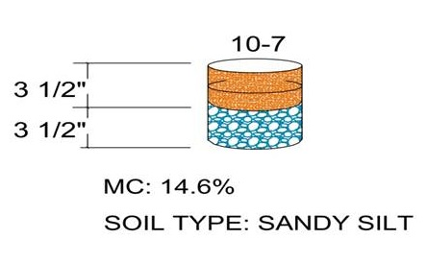
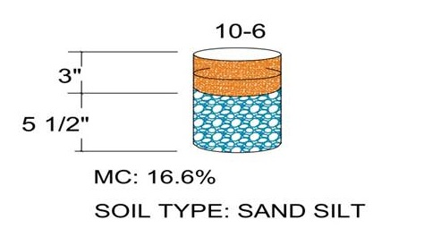
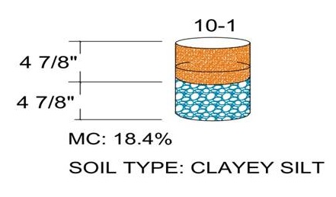
AS–BUILT VARIATIONS

Slide 15
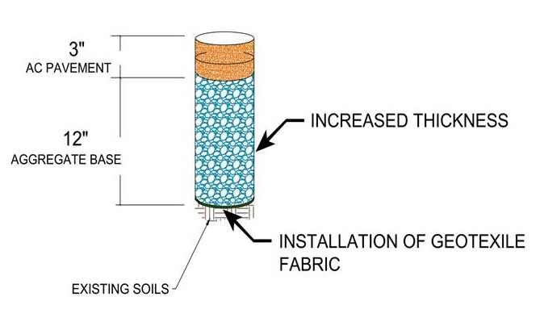
DESIGNED REPLACEMENT SECTION

Slide 16
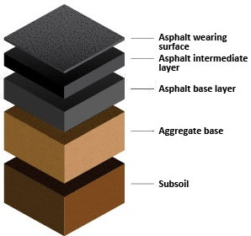
Designed Replacement
3”
12”
Endurance / Life / Durability
Sample Illustration Only

Slide 17
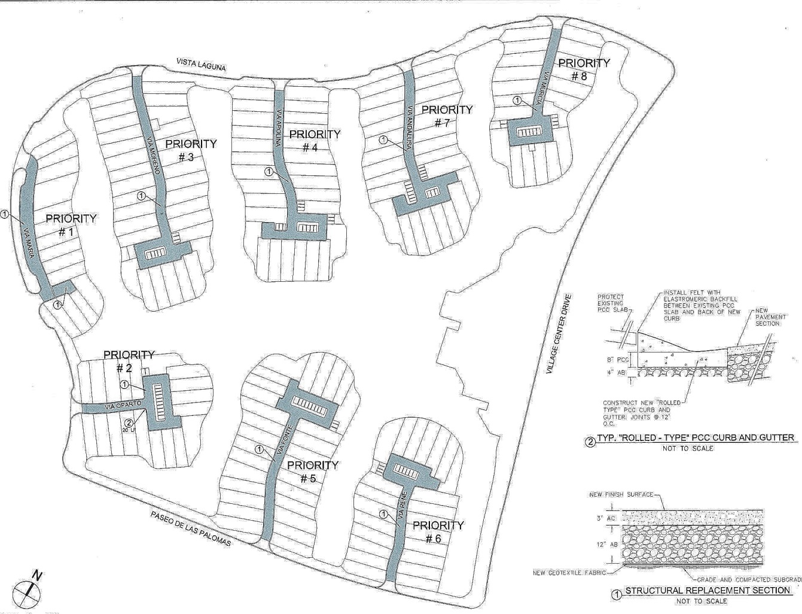
East Lake Villages Shores Street Rehab & Paving by Priority
7
3
1
4
8
Priority Street Projected Schedule
Via Maria 2017
Via Oporto
Via Morena 2018
Via Apolina
5 Via Fonte 2019
6 Via Rene
7 Via Andalusia 2020
8 Via Murcia
5
6
2

Slide 18
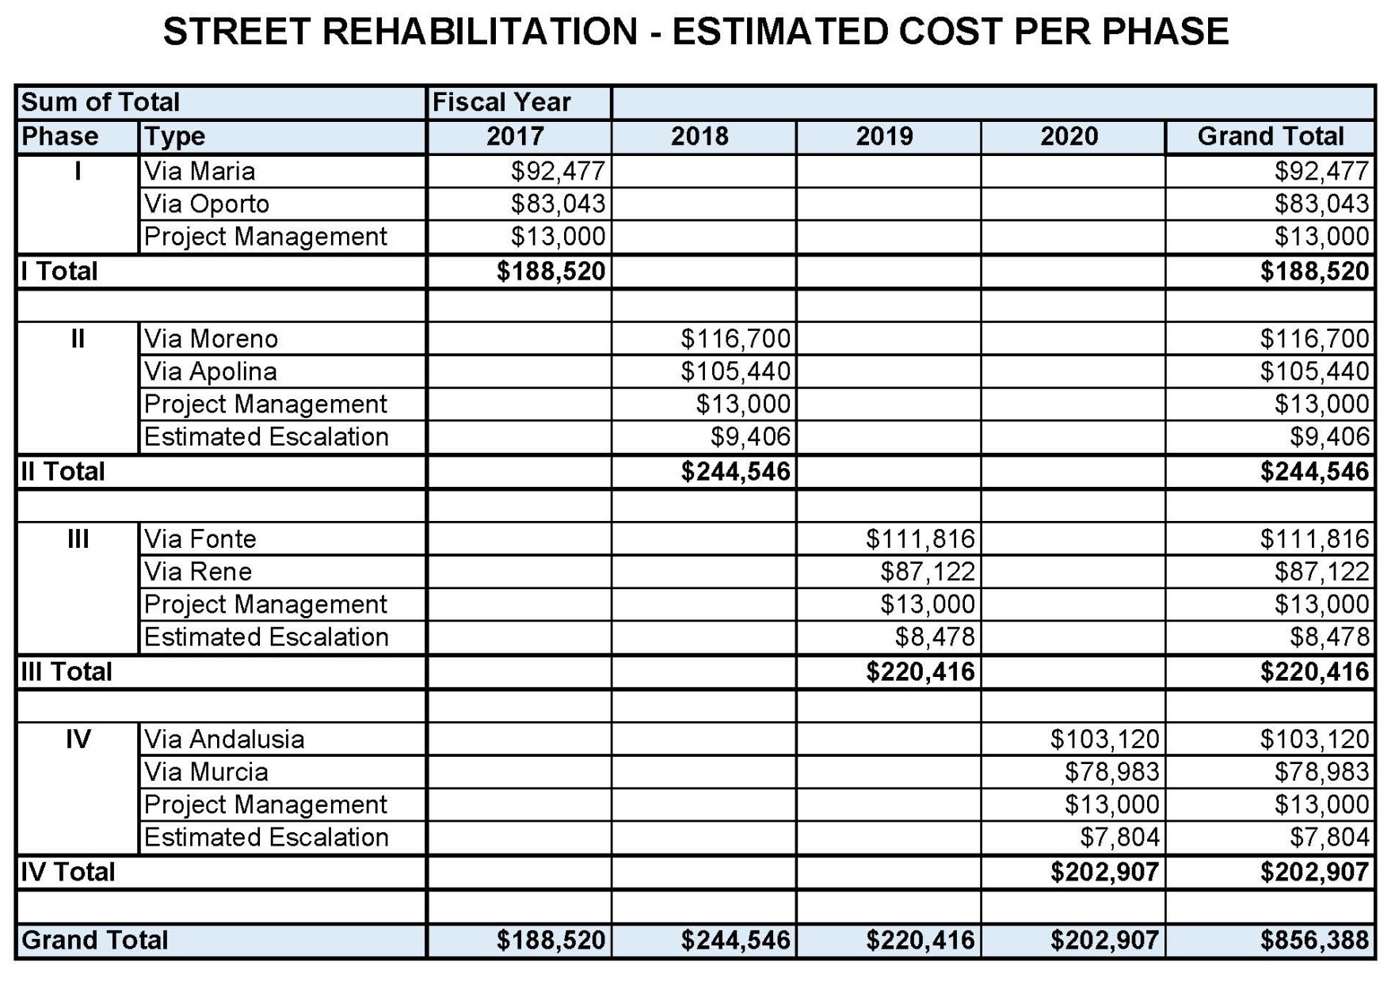

Slide 19
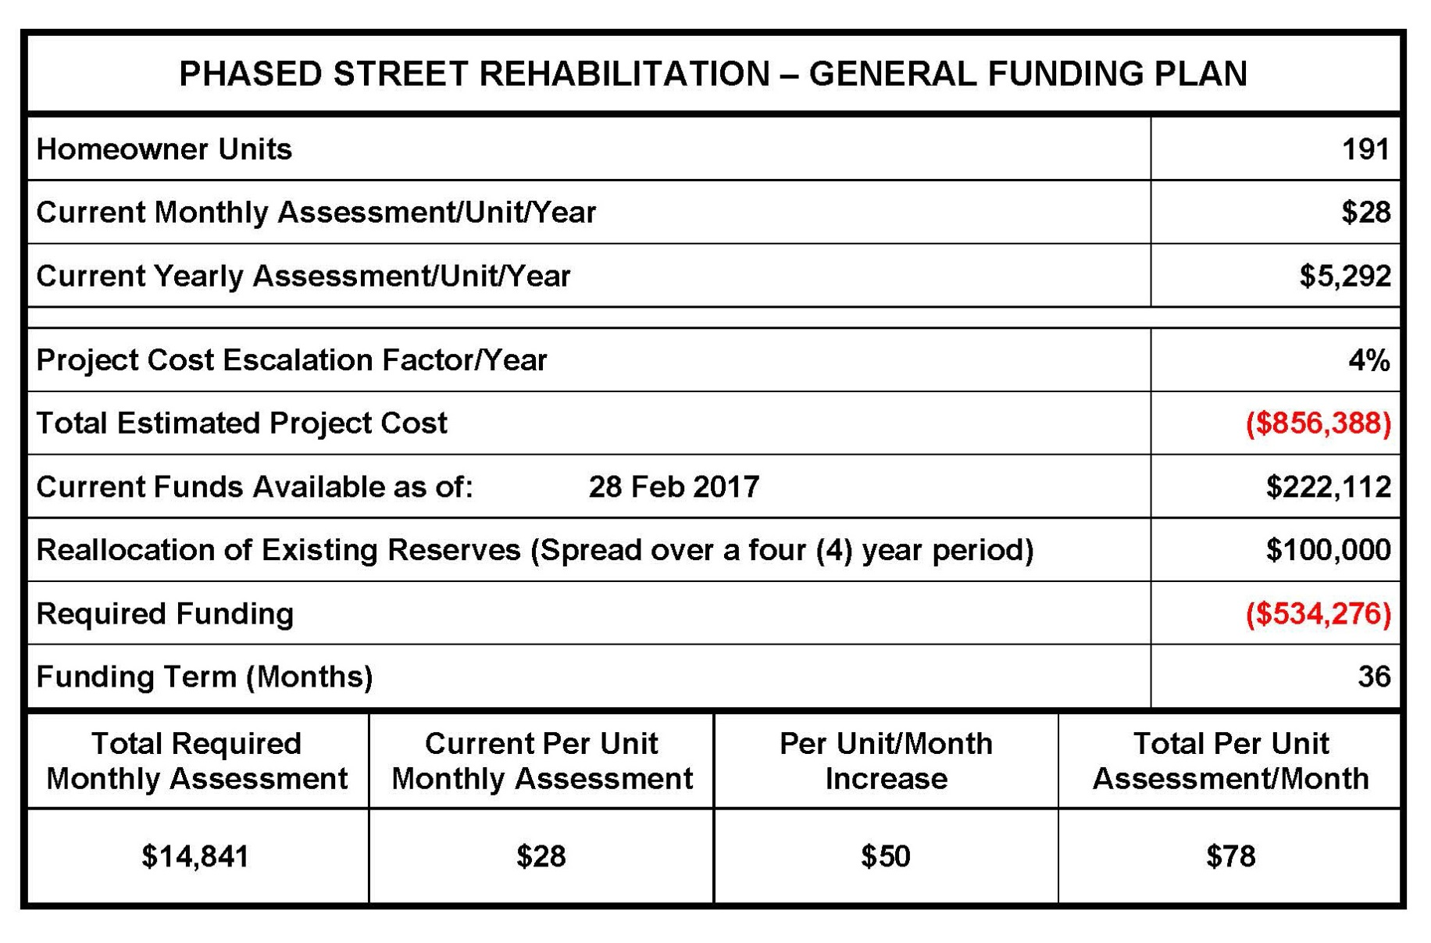

Slide 20
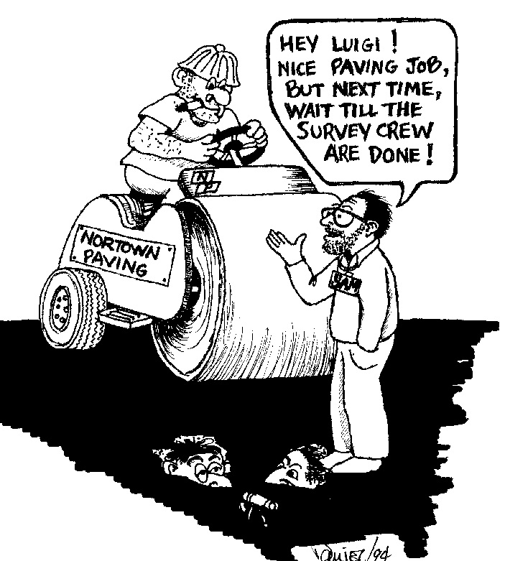
Communicate
Communicate
Communicate

Slide 21
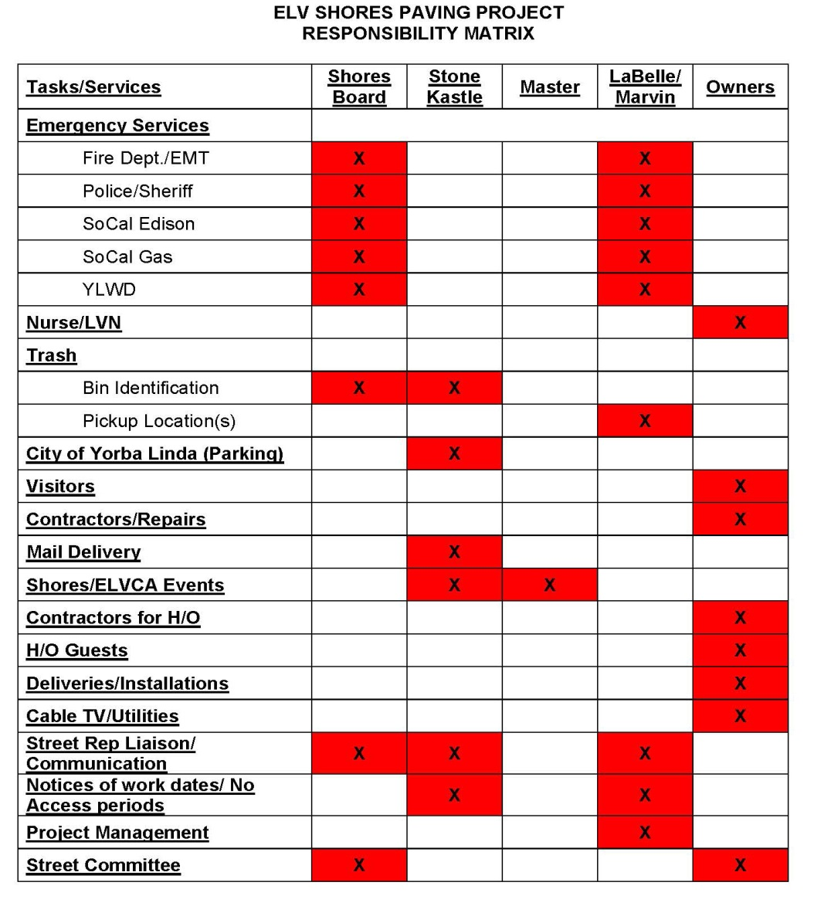
Planning In Detail
All-Point Considerations
Providing Answers Ahead
Follow-Up Methods
A “Community” Effort

Slide 22
Covering The Bases:
Parking
Emergency Access
Nurse
Trash Pickup
Visitors
Contractors/Repairs
Mail Delivery
Other Deliveries
Liaison with
Fire Dept./EMTs
Postal Services
Police/Sheriff
Disposal Co.
… and many more!
Pickup

Slide 23
How We’ll Keep You Informed
You Deserve the Right to Know

Slide 24
Today - printout of this presentation
- placement on ELVSCA Website
Detail Schedules and Reminders Before
Work Starts on your street
FAQ – Answers to most frequently asked questions posted to website
Updates by your Street Rep, Board and StoneKastle

Slide 25
East Lake Village Shores Community Association
Street Rehabilitation & Paving Plan

